Slide 1
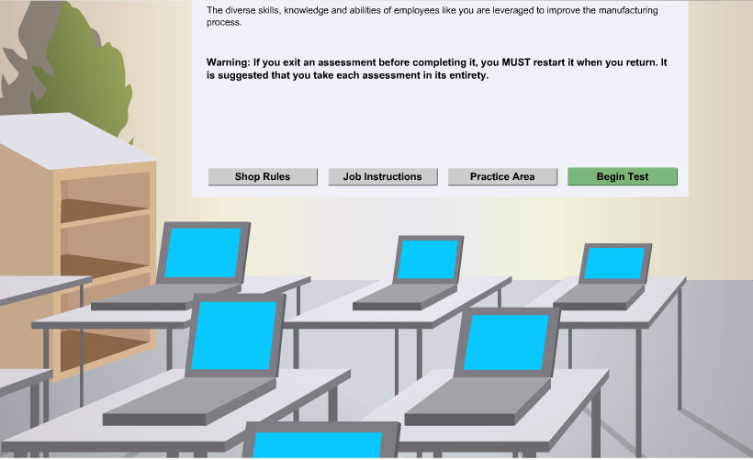
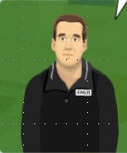
"Welcome. I'm your virtual coach. This exercise is a pre-requisite for attending:
Electrical, Terminals and Connectors #18043.04H. After completing this simulation you will be able to;
1. Perform voltage measurements using the MIN-MAX feature on the DMM.
2. Understand the use of a reverse bias diode in a circuit.
It is estimated that it will take 10-15 minutes to complete this session.
Please click Next to continue."
Warning: If you exit this simulation before completion, you MUST restart it when you return. It is strongly suggested that you take this and each simulation in its entirety.
ETC06_Intro

Slide 2
"For this portion of the exercise in this workstation you will:
1. Measure the voltage drop of the relay coil while operating the circuit, using the MIN-MAX feature of the DMM.
2. Observe the minimum and maximum voltages.
3. Determine the effects on a circuit when a relay controls loads.
Please click continue when you are ready to move forward."
Continue
ETC06_001_01

Slide 3
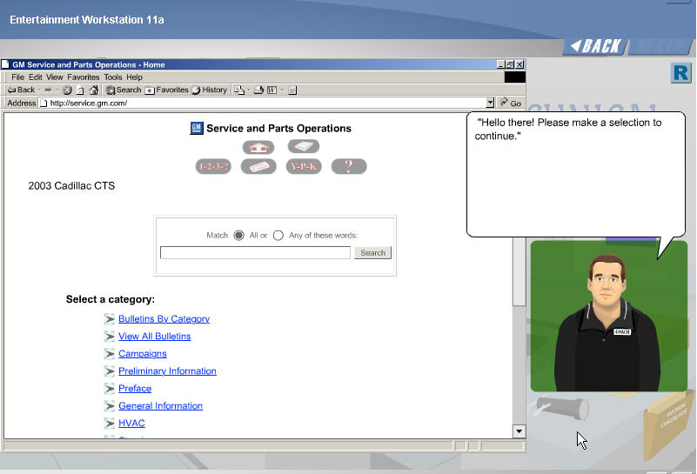
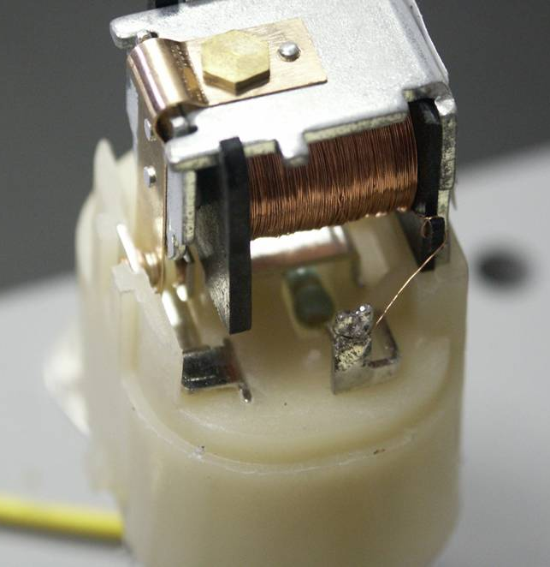
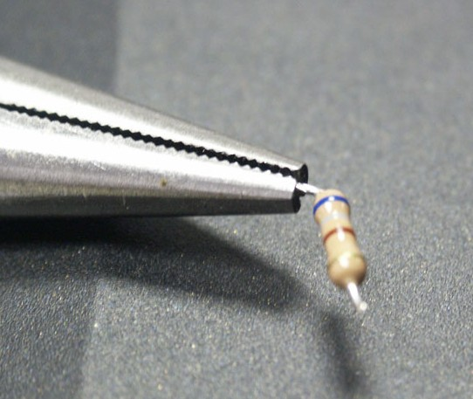
Electrical, Terminal & Connectors
“The relay used during this workstation has been modified slightly. The resistor inside the relay has been removed.
Please click continue when you are ready to proceed.
Draw this picture without the
resistor but have a blown up
picture of the resistor removed
next to this graphic.
Use resistor_relay.jpg as reference
for color bands.
Continue
ETC06_001_02

Slide 4
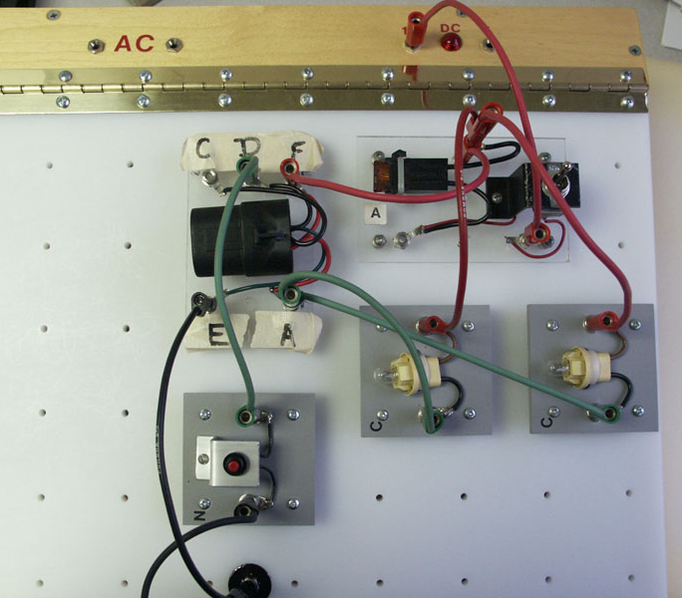
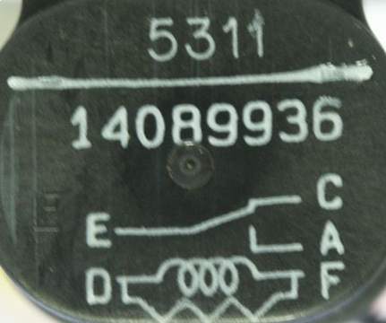
Electrical, Terminal & Connectors
Popup Coach:
"Click the toggle switch to power up the circuit. Perform a voltage measurement over the relay coil.
Click the SI button below at any time if you need assistance performing the DMM measurements.”
Insert info from pic0381.jpg
on top of this component
for entire exercise.
Continue
SI Document
button
Set board.jpg
ETC06_001_03

Slide 5
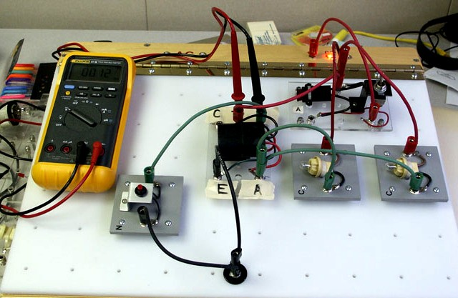
Electrical, Terminal & Connectors
Instructions:
1. Drag and drop test leads to meter’s input terminals.
2. Click on appropriate rotary switch setting.
3. Drag and drop test leads to coil terminals on the relay.
Note: Remove mouse pointer from test lead to have DMM operate properly.
Click continue when you are ready.
SI Document
button
Continue
DMM hooked up.jpg
ETC06_001_04

Slide 6
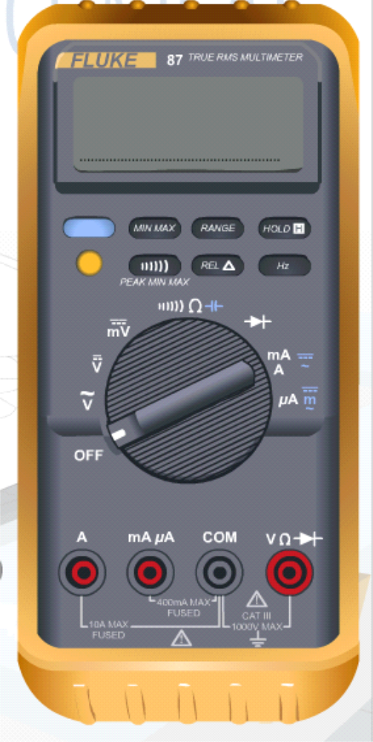
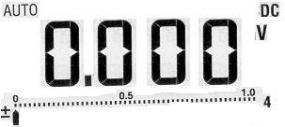
Electrical, Terminal & Connectors
Instructions:
1. Click the range button on the DMM to the 1000v scale setting.
001.jpg
SI Document
button
Set board.jpg
ETC06_001_05

Slide 7
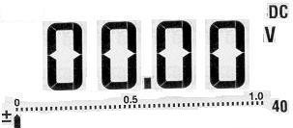
Electrical, Terminal & Connectors
Instructions:
1. Click the range button on the DMM to the 1000v scale setting.
003.jpg
SI Document
button
Set board.jpg
ETC06_001_06

Slide 8
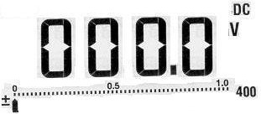
Electrical, Terminal & Connectors
Instructions:
1. Click the range button on the DMM to the 1000v scale setting.
004.jpg
SI Document
button
Set board.jpg
ETC06_001_07

Slide 9
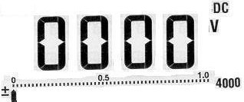
Electrical, Terminal & Connectors
Instructions:
1. Click the range button on the DMM to the 1000v scale setting.
Popup Coach:
"Good, now you’re on the 1000v scale setting. Click continue to proceed."
005.jpg
SI Document
button
Continue
Set board.jpg
ETC06_001_07.1

Slide 10
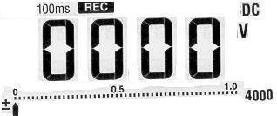
Electrical, Terminal & Connectors
Instructions:
1. Click the MIN-MAX button on the DMM to select the record feature.
006.jpg
SI Document
button
Continue
Set board.jpg
ETC06_001_08

Slide 11
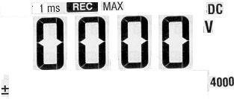
Electrical, Terminal & Connectors
Instructions:
1. Click the Peak MIN-MAX button on the DMM to select the 1ms time interval record setting.
007.jpg
SI Document
button
Continue
Set board.jpg
ETC06_001_09

Slide 12
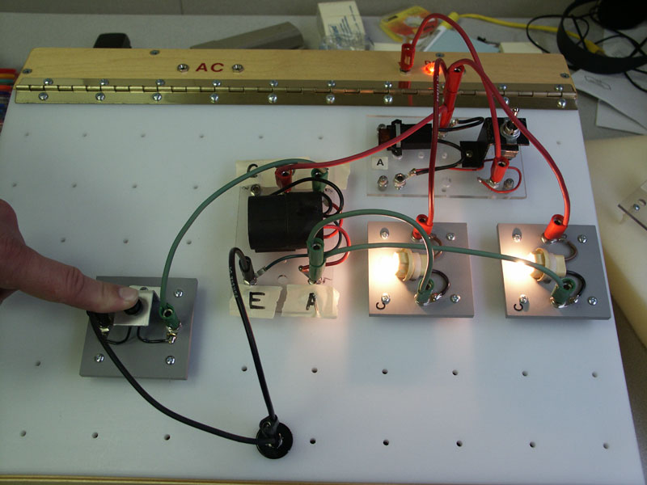
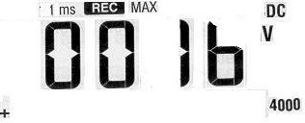
Electrical, Terminal & Connectors
Instructions:
1. Operate the micro-switch on the set board to obtain the readings.
008.jpg
SI Document
button
Continue
Lamps lit.jpg
ETC06_001_10

Slide 13
Electrical, Terminal & Connectors
Document ID327359
2004 Cadillac De Ville
Measuring Voltage Drop
(Refer to SI document)
Close
ETC06_001_10.1

Slide 14
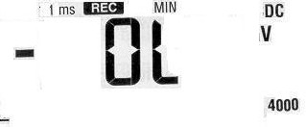
Electrical, Terminal & Connectors
NEXT
Instructions:
1. Observe the maximum voltage reading.
2. Click the MIN-MAX button on the DMM to observe the minimum voltage readings.
Click Next to continue.
009.jpg
SI Document
button
Lamps lit.jpg
ETC06_001_13

Slide 16
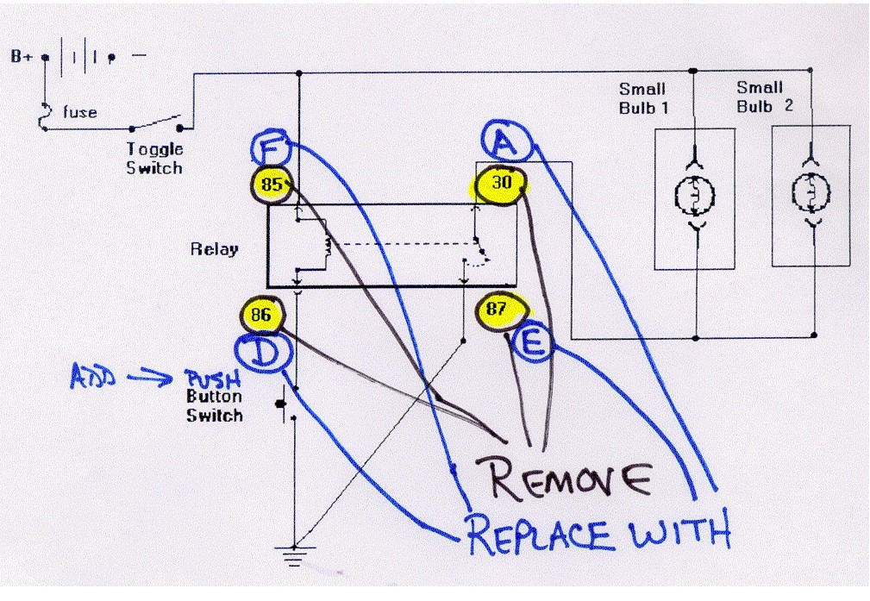
Electrical, Terminal & Connectors
Popup Coach:
"Great, now that you’ve operated the circuit and observed the DMM readings, let’s take a look at what’s happening during the circuit’s power cycle. Click Continue to take a look.”
Flash of voltage spike within the circuit and the diode.
Use go-by (pages 001a – 009a). Text on pages is popup coach bubble text.
Continue
ETC06_002

Slide 17
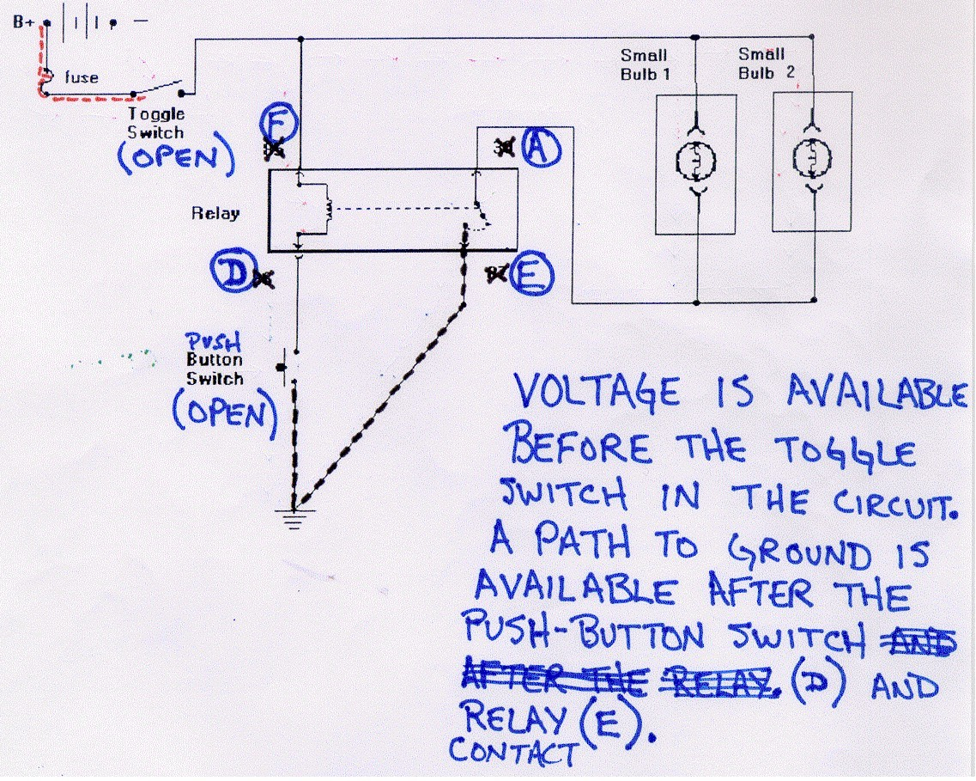
2_2a

Slide 18
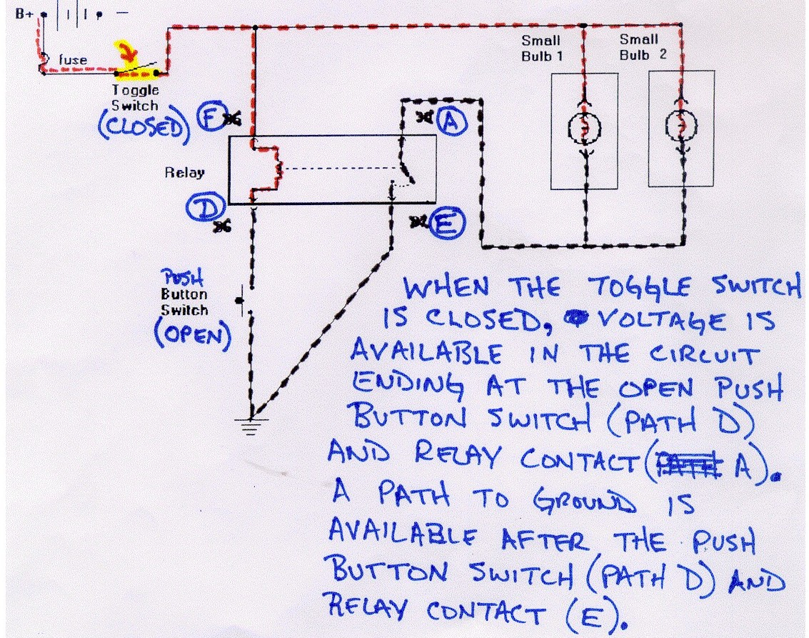
2_3a

Slide 19
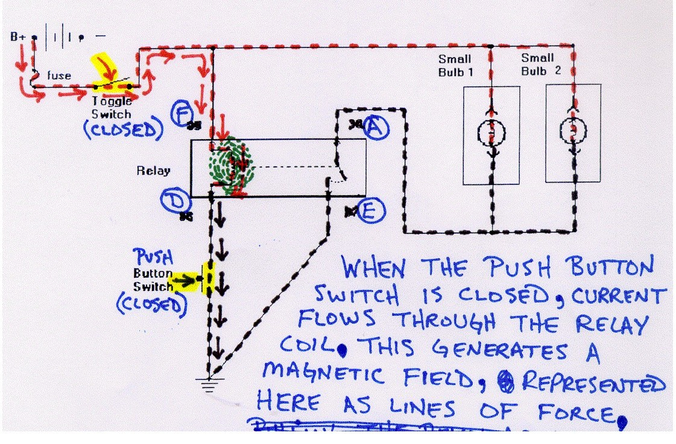
2_4a

Slide 20
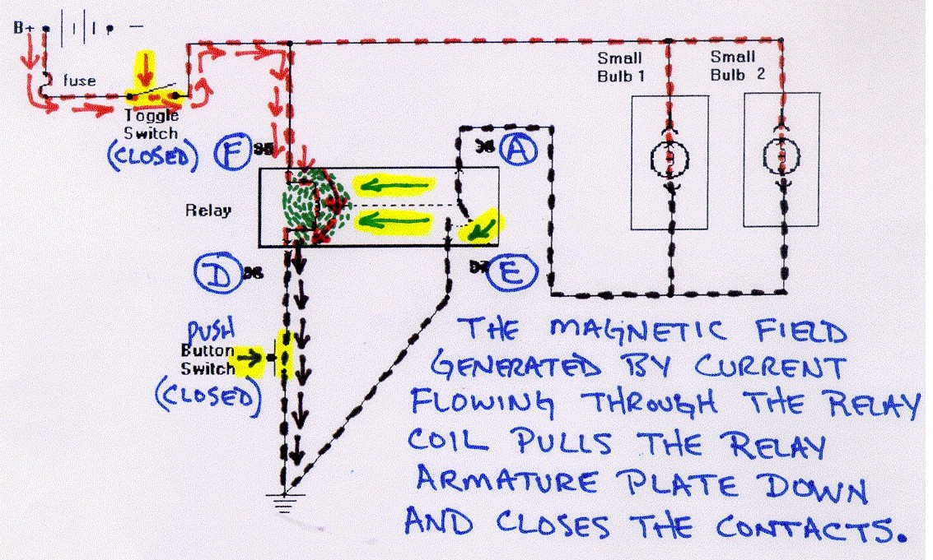
2_5a

Slide 21
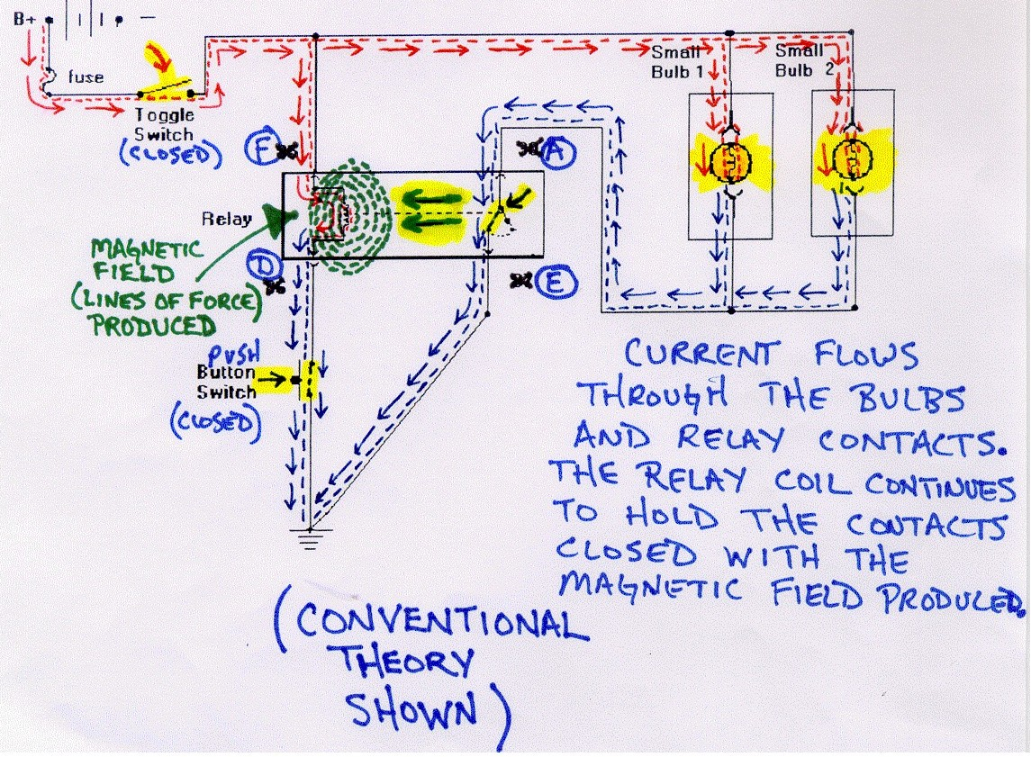
2_6a

Slide 22
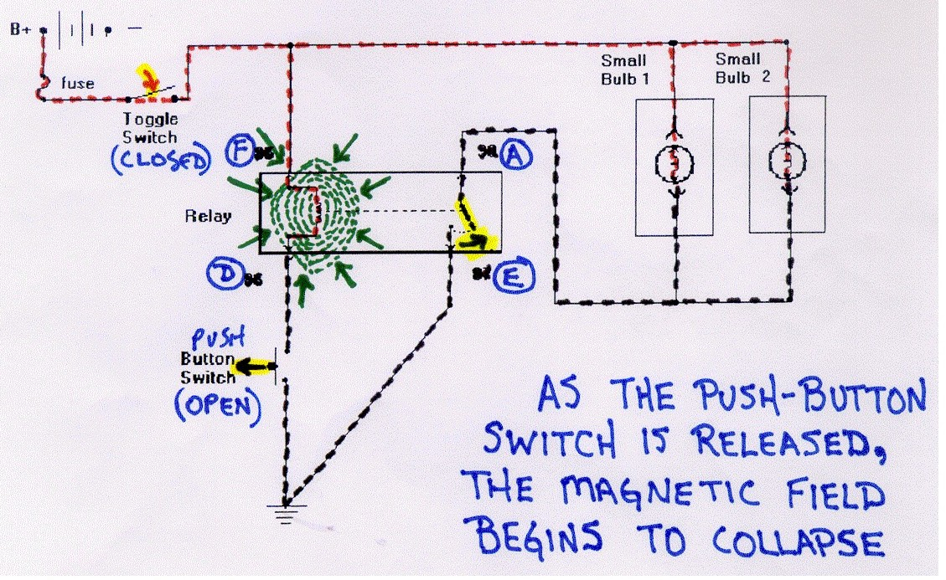
2_7a

Slide 23
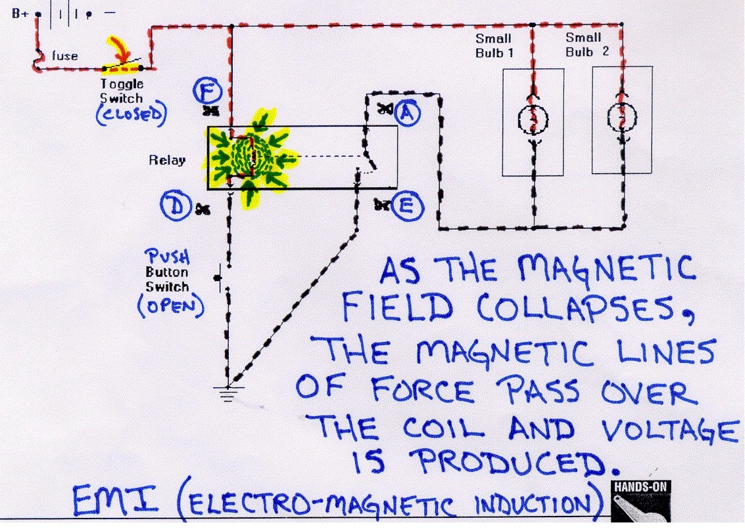
2_8a

Slide 24
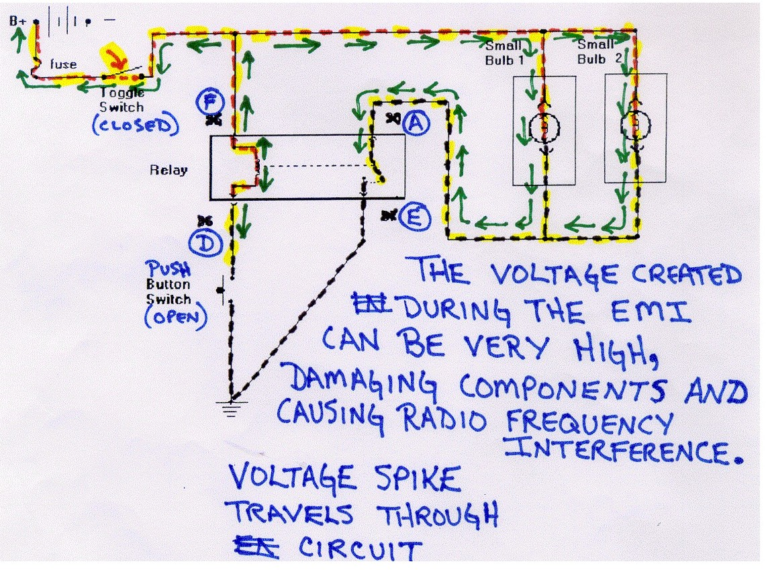
2_9a

Slide 25
“Lets see what happens when a reverse bias diode is added to the circuit parallel to the relay coil. Please click continue when you’re ready. Please click Next when you are ready to move forward."
NEXT
ETC06_002b

Slide 27
Popup Coach:
"For this portion of the exercise in this workstation you will:
1. Measure the voltage drop of the relay coil while operating the circuit, using the MIN-MAX feature of the DMM.
2. Observe the minimum and maximum voltages.
3. Compare the readings to the measurements obtained without the diode in the circuit (16v MAX; -OL MIN).
4. Determine the effects on a circuit when a relay controls loads and a reverse bias diode is installed parallel to the relay’s coil.
Please click continue when you are ready to move forward."
Continue
ETC06_005_00

Slide 28
“Click on any of the links below to learn more about Diodes. If you feel you have enough information, please click the continue button when you’re ready to proceed."
Diode Characteristics
Forward Biased Diode
Reverse Biased Diode
Light Emitting Diode
Testing Diodes
Continue
ETC06_005_01

Slide 29
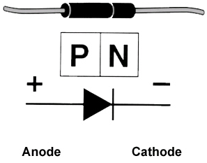
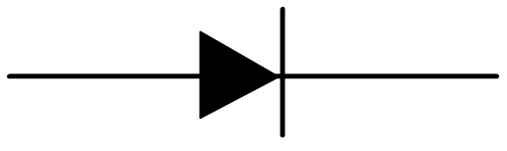
Electrical, Terminal & Connectors
Characteristics of Standard Diodes
Only allow current flow in one direction
Act as a one-way gate
Schematic symbol – the triangle shows the direction of current flow
Positive side of diode = Anode
Negative side of diode = Cathode
P-N Junction – Area where the two materials meet
Continue
ETC06_005_02

Slide 30
Forward Biased Diode Info
Electrical, Terminal & Connectors
Continue
ETC06_005_03

Slide 31
Reverse Bias Diode Info
Electrical, Terminal & Connectors
Continue
ETC06_005_04

Slide 32
Light Emitting Diode Info
Electrical, Terminal & Connectors
Continue
ETC06_005_05

Slide 33
Testing Diode Info
Electrical, Terminal & Connectors
Continue
ETC06_005_06

Slide 34
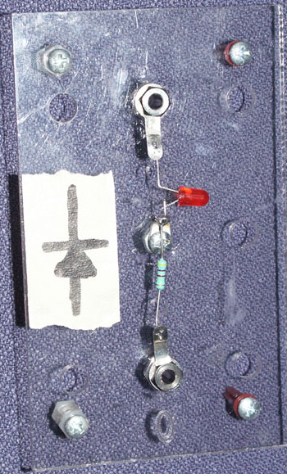
Electrical, Terminal & Connectors
“Popup Coach:
"In the next portion of the exercise,
a diode is placed in the circuit parallel to the relay coil. The diode is reverse biased. A light emitting diode
(LED) has been used to show the effects
the diode has on the circuit. Pay attention
to it during your circuit tests.
In an LED, a small lens is built into the diode so the light can be seen. When the LED is forward biased, it illuminates. When the LED is reverse biased, it prevents current flow. The LED operates at about 1.5v so a dropping resistor is needed to prevent damage to the LED.
Select continue when you are ready to
move forward."
Continue
ETC06_003_03

Slide 35
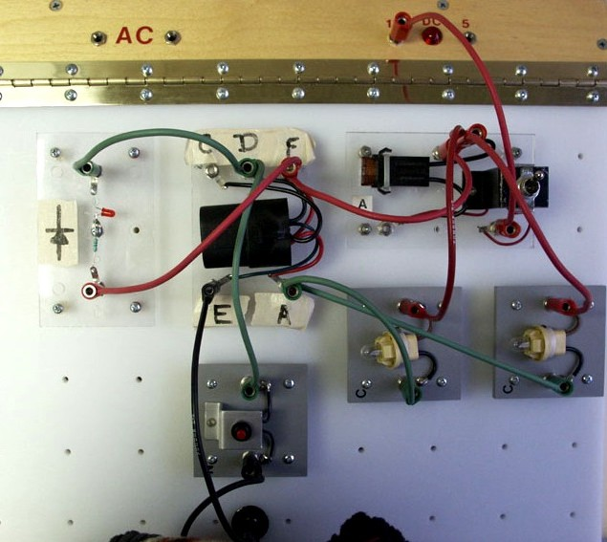
Electrical, Terminal & Connectors
Popup Coach:
"Click the toggle switch to power up the circuit. Perform a voltage measurement over the relay coil.
Click the SI button below at any time if you need assistance performing the DMM measurements.”
Insert info from pic0381.jpg
on top of this component
for entire exercise.
Continue
SI Document
button
Set board.jpg
ETC06_003_04

Slide 36
Electrical, Terminal & Connectors
Instructions:
1. Drag and drop test leads to meter’s input terminals.
2. Click on appropriate rotary switch setting.
3. Drag and drop test leads to coil terminals on the relay.
Note: Remove mouse pointer from test lead to have DMM operate properly.
Click continue when you are ready.
Dial should be
set to here for
entire exercise
SI Document
button
Continue
Set board w diode.jpg
ETC06_003_05

Slide 37
Electrical, Terminal & Connectors
Instructions:
1. Click the range button on the DMM to the 1000v scale setting.
001.jpg
SI Document
button
Set board w diode.jpg
ETC06_003_06

Slide 38
Electrical, Terminal & Connectors
Instructions:
1. Click the range button on the DMM to the 1000v scale setting.
003.jpg
SI Document
button
Set board w diode.jpg
ETC06_003_07

Slide 39
Electrical, Terminal & Connectors
Instructions:
1. Click the range button on the DMM to the 1000v scale setting.
004.jpg
SI Document
button
Set board w diode.jpg
ETC06_003_08

Slide 40
Electrical, Terminal & Connectors
Instructions:
1. Click the range button on the DMM to the 1000v scale setting.
005.jpg
SI Document
button
Set board w diode.jpg
ETC06_003_08.1

Slide 41
Electrical, Terminal & Connectors
Instructions:
1. Click the MIN-MAX button on the DMM to select the record feature.
006.jpg
SI Document
button
Set board w diode.jpg
Continue
ETC06_003_09

Slide 42
Electrical, Terminal & Connectors
Instructions:
1. Click the Peak MIN-MAX button on the DMM to select the 1ms time interval record setting.
007.jpg
SI Document
button
Continue
Set board w diode.jpg
ETC06_003_10

Slide 43
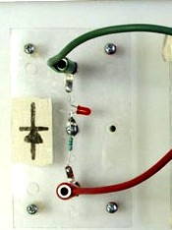
Electrical, Terminal & Connectors
Instructions:
Click the push button micro-switch on the set board to operate the relay and obtain your DMM measurements.
Click continue.
As user clicks the switch,
lamps turn off and diode flickers
for a brief second.
008.jpg
SI Document
button
Continue
Lamps lit.jpg
ETC06_003_11

Slide 44
Electrical, Terminal & Connectors
Document ID327359
2004 Cadillac De Ville
Measuring Voltage Drop
(Refer to SI document)
Close
ETC06_003_11.1

Slide 45
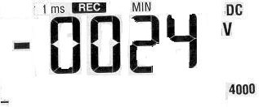
Electrical, Terminal & Connectors
Instructions:
Observe the maximum voltage reading.
Click the MIN-MAX button again to obtain the minimum reading.
Click continue.
010.jpg
SI Document
button
Continue
Set board w diode.jpg
ETC06_003_12

Slide 47
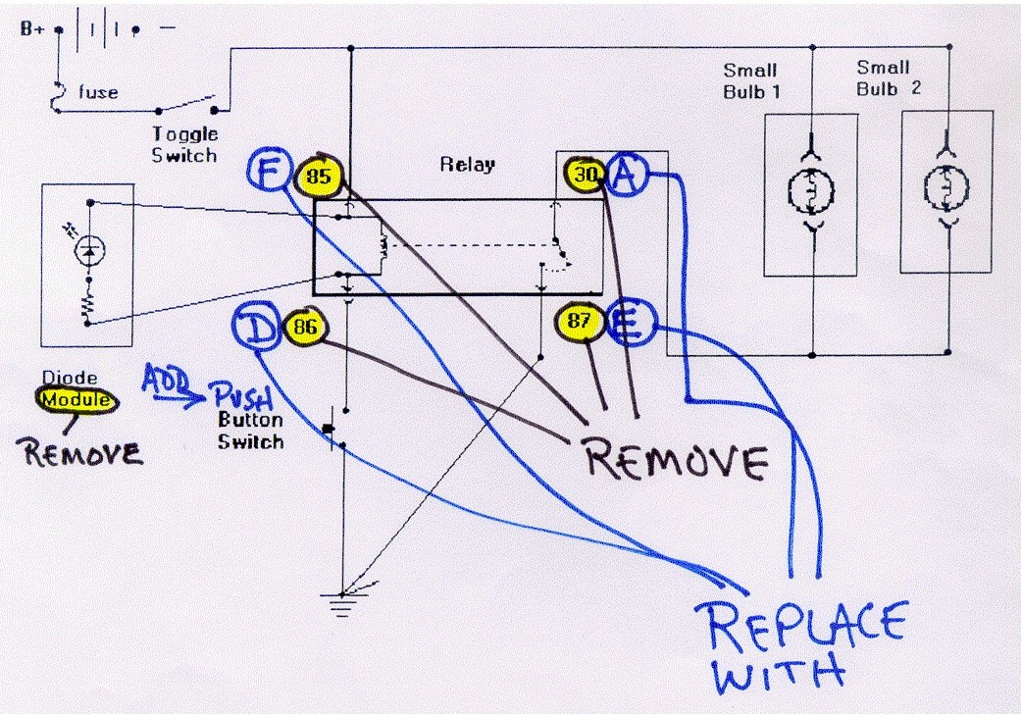
Electrical, Terminal & Connectors
Popup Coach:
"Great, now that you’ve operated the circuit and observed the DMM readings, let’s take a look at what’s happening during the circuit’s power cycle. Click Continue to take a look.”
Flash of voltage spike within the circuit and the diode.
Use go-by (pages 001b – 009b). Text on pages is popup coach bubble text.
Continue
ETC06_004_01

Slide 48
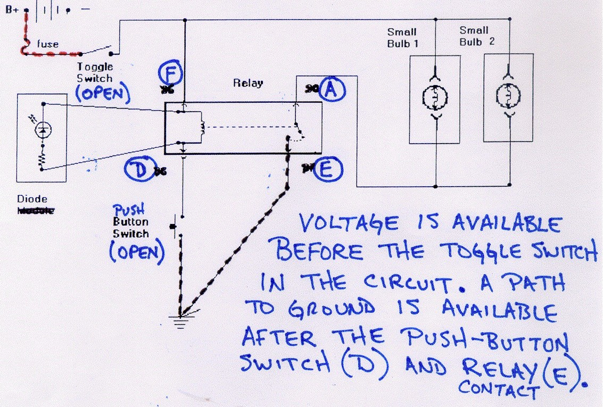
4_2b

Slide 49
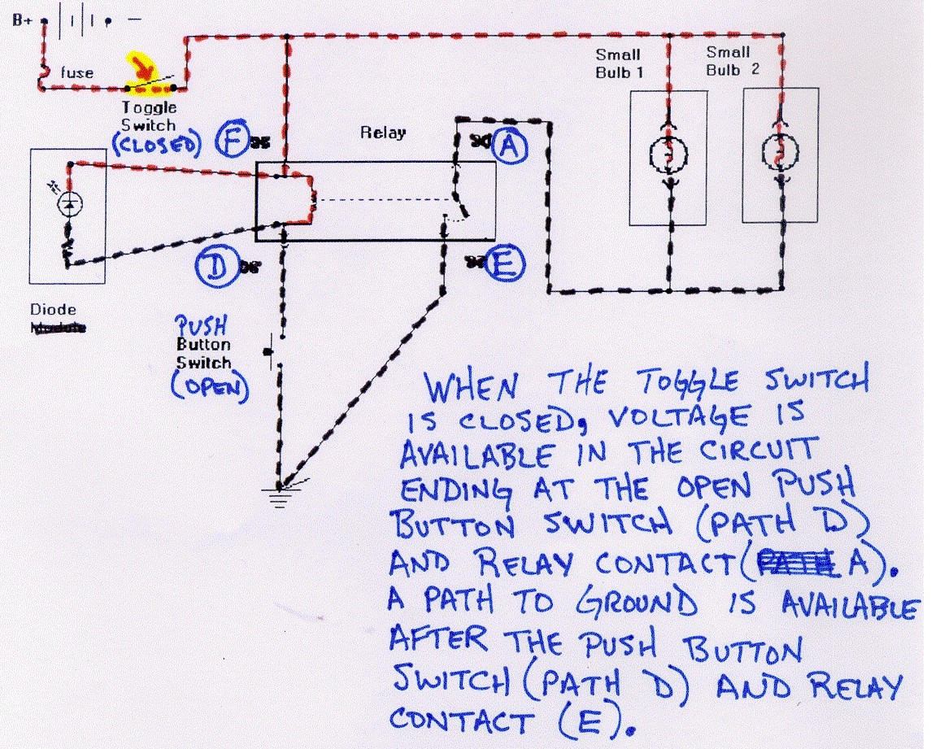
4_3b

Slide 50
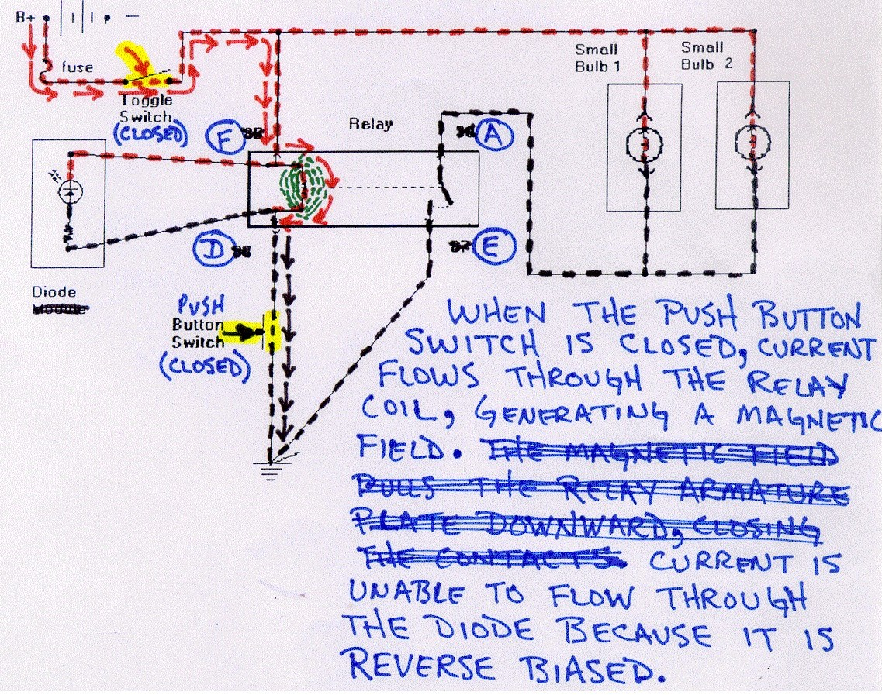
4_4b

Slide 51
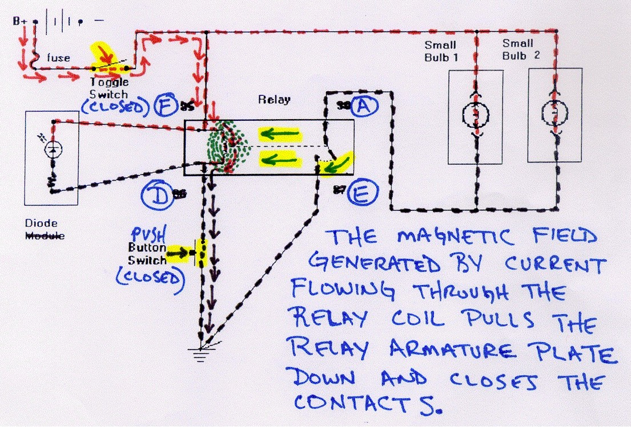
4_5b

Slide 52
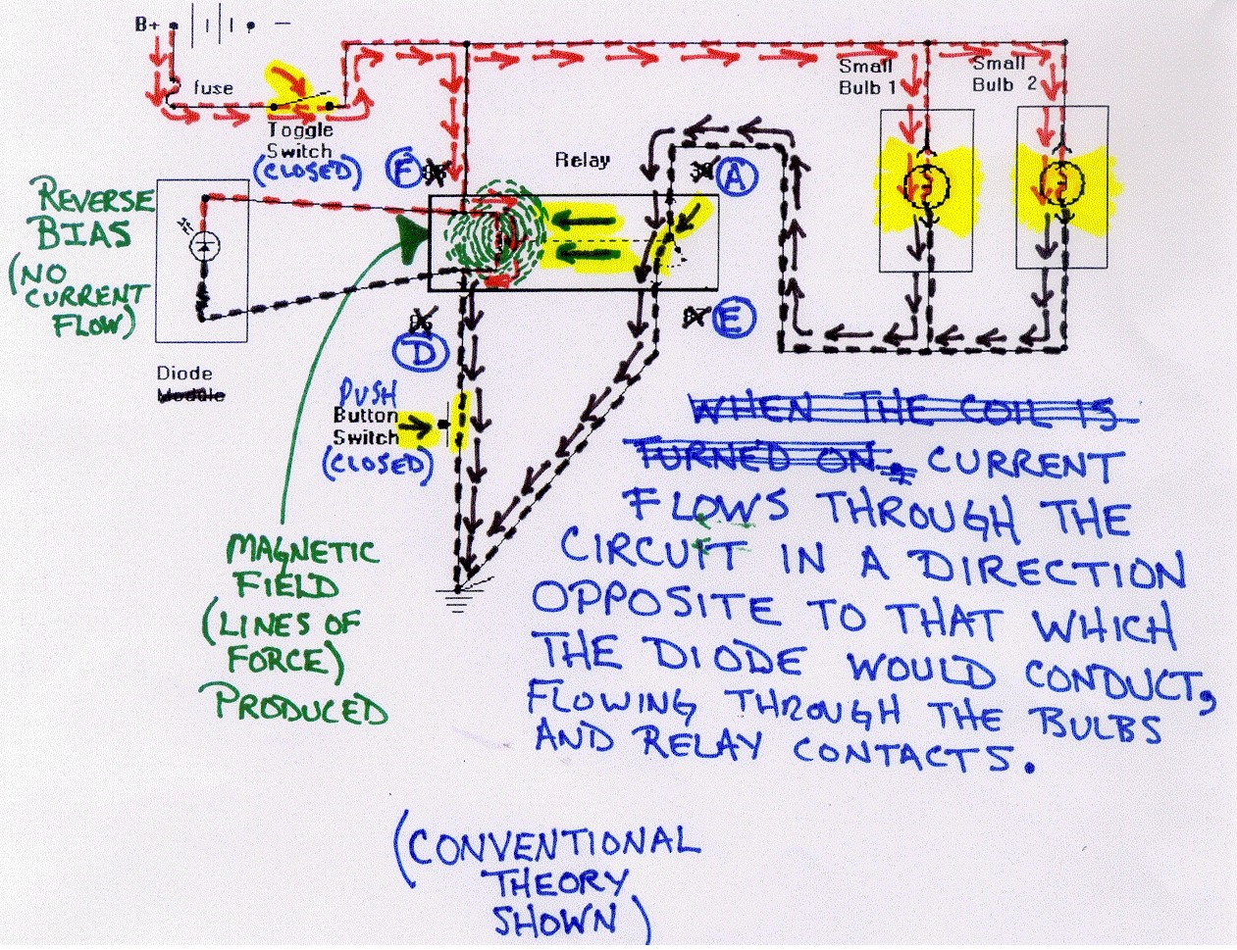
4_6b

Slide 53
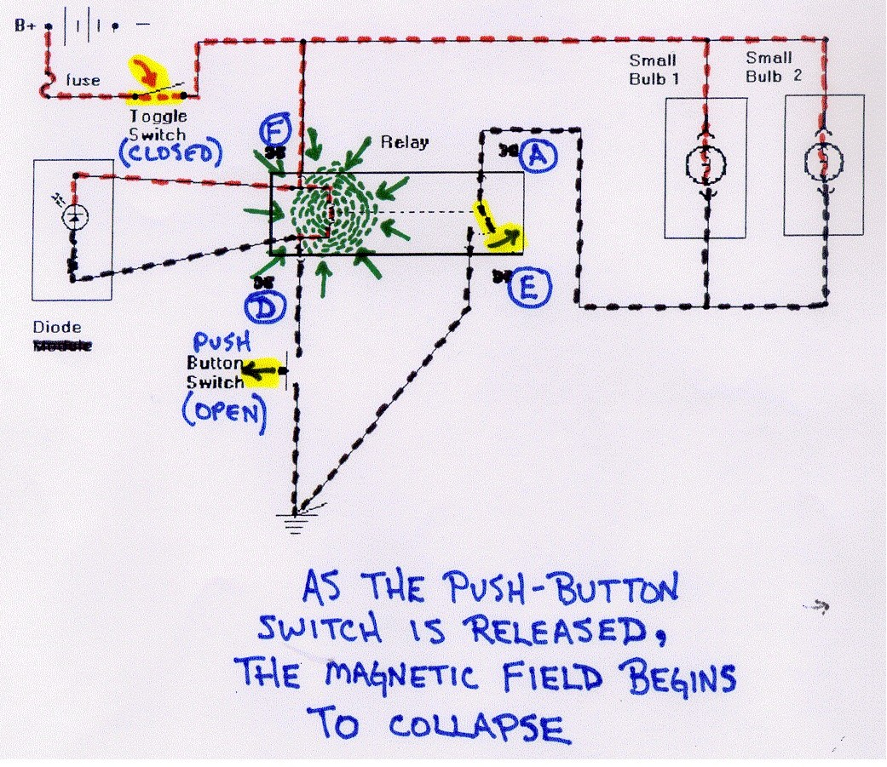
4_7b

Slide 54
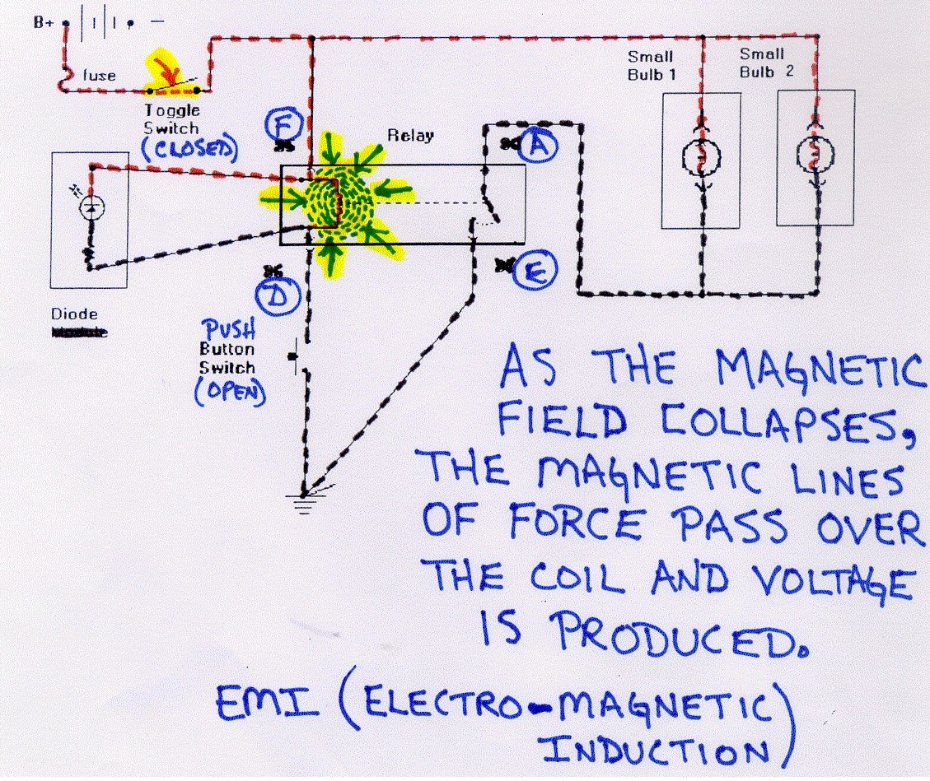
4_8b

Slide 55
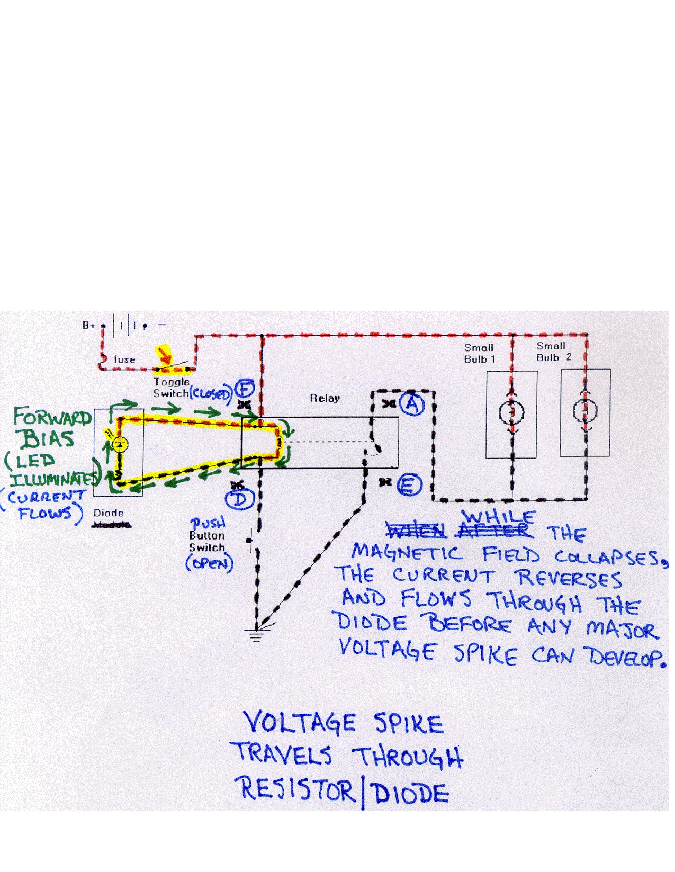
4_9b

Slide 56
Popup Coach:
“Which effect does adding a reverse bias diode
parallel to the relay coil have on this circuit?
A. The diode provides a controlled path for current to flow when
the circuit is opened until the induced voltage dissipates.
B. The diode reduces the current flow when the circuit is closed,
resulting in lower voltage surges.
C. The diode amplifies the magnetic field produced by the
relay coil during circuit operation.
D. The diode increases the output of other loads in
the circuit during relay operation.
Continue
ETC06_004_02

Slide 57
“In an electrical schematic, the diode symbol
arrow indicates the _____________________________________.
A. direction of current flow when the diode is
preventing current from flowing across the P-N junction
B. diode’s dropping resistance lead placement orientation when the diode is reverse bias
C. direction of current flow when the diode is conducting and current is flowing across the P-N junction
D. maximum rated load specification of the
diode before diode failure occurs
Continue
ETC06_004_03

Slide 58
Popup Coach:
"Click the links below to review some of the electrical characteristics of this circuit.
If you would like to move on, please click Next.”
Electromagnetic Induction
Clamping Diodes
Diodes – Vehicle Usage
Current Flow Theory
Next
ETC06_004_04

Slide 59
Electromagnetic Induction Info
Electrical, Terminal & Connectors
Continue
ETC06_004_05

Slide 60
Clamping Diode Info
Electrical, Terminal & Connectors
Continue
ETC06_004_06

Slide 61
Diodes – Vehicle Usage Info
Electrical, Terminal & Connectors
Continue
ETC06_004_07

Slide 62
Current Flow Theory Info
Electrical, Terminal & Connectors
Continue
ETC06_004_08

Slide 64
Summary
Next
ETC06_001_33

